Slide 1
Many body system measurement part
Speaker: Jay
Advisor: Prof. Lin
Co-Advisor: Prof Hoi

Slide 2
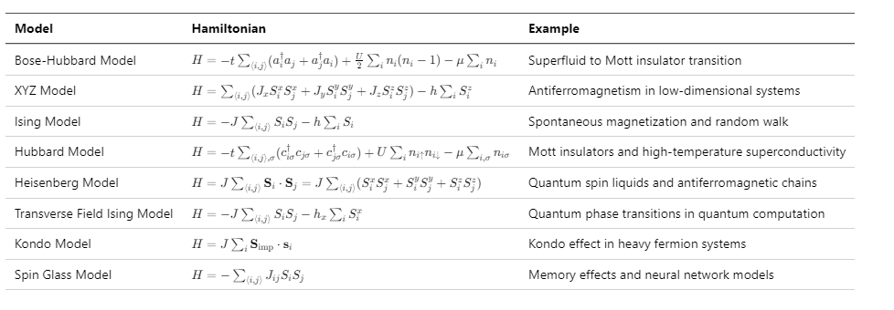
Introduce many body system

Slide 3
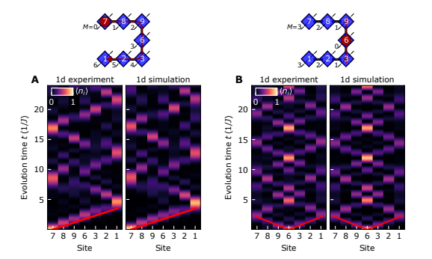
First step for many body system
Extract the population
System optimal control
Random work → Done by W.D oliver group on Transmon

Slide 4
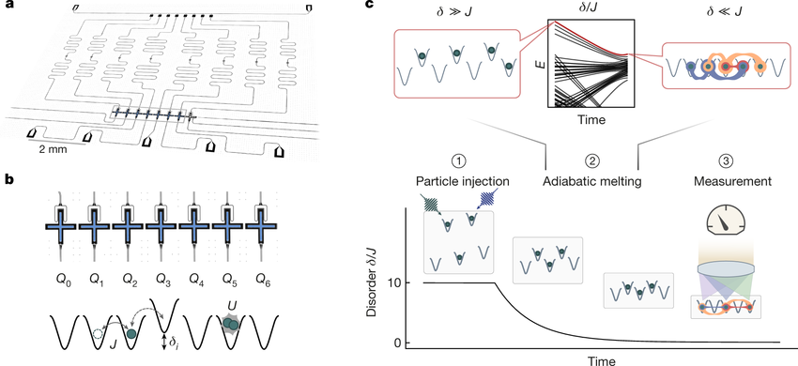
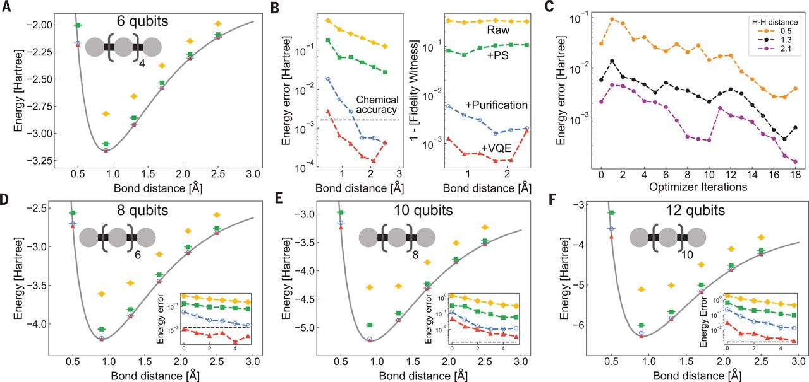
Other example
Bose-Hubbard
: spinless bosons on a lattice
Hartree-Fock: nuclear physics

Slide 5
Recap previous
In previous measurement
No time domain data
Bad resonator quality factor → Hard to readout (Qi & Qc < 10^4)
No fully developed measurement step
Fitting and Qick code not fully refined

Slide 6
Outline
One tone
Spectrum
Circuit fit
One tone vs flux
Power dependent
Two tone
Spectrum
Two tone vs flux
Time domain
Time domain
Rabi
T1
T2
Power optimize
Single shot
Optimize

Slide 7
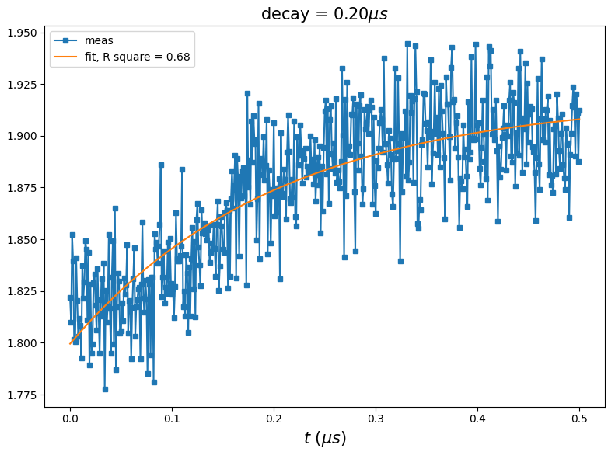
Driving to steady state and moving readout
Qubit drive
RO
RO

Slide 8
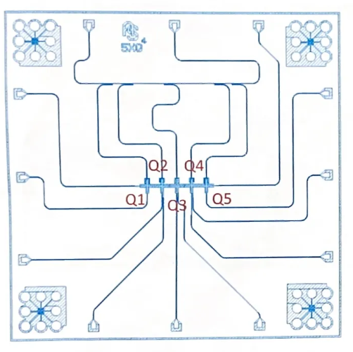
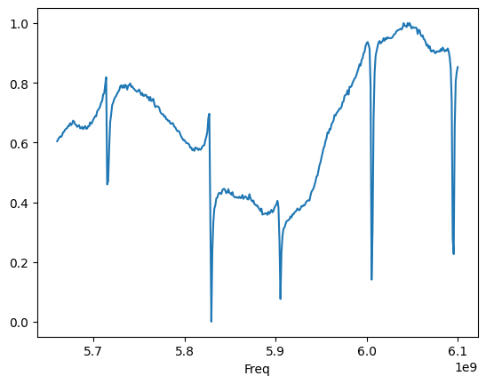
One tone
r1
r4
r2
r3
r5

Slide 9
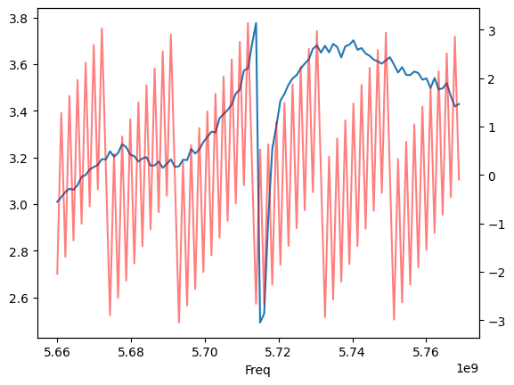
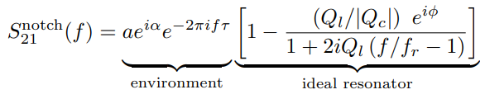
Circle fit
quick oscillation → environment
The time it takes an electrical signal to pass through it

Slide 10
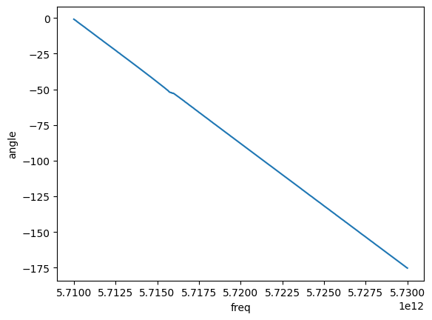
Phase correct
Freq vs phase in small range

Slide 11
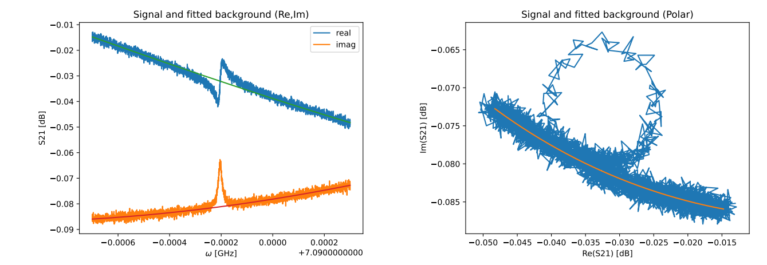
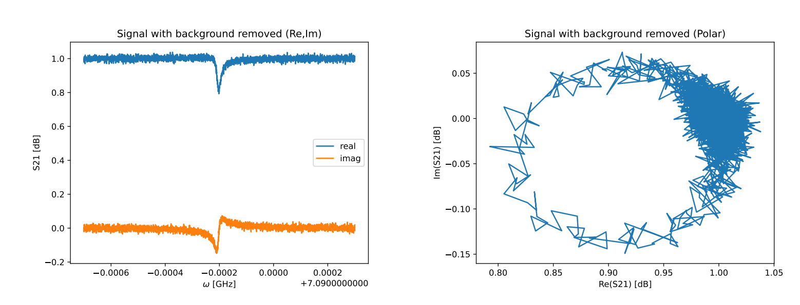
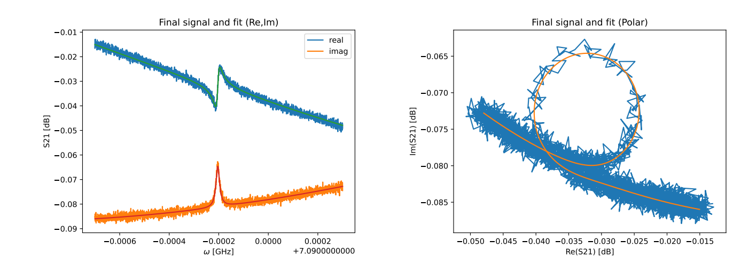
Notes:
Development of Niobium Superconducting Microwave Resonators, Felix Fischer

Slide 12
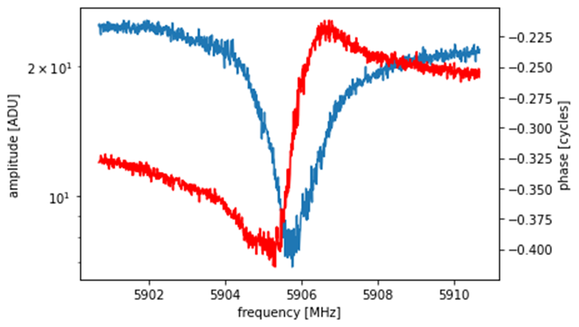
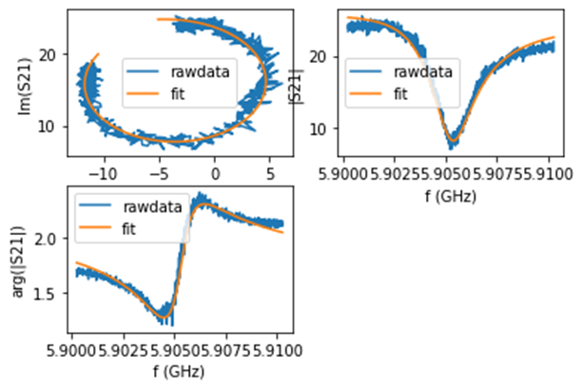
Phase correct
Freq vs phase in small range
Avg. Qi ~ 2e4
Avg. Qc~ 8e3
Notes:
Coupling Harmonic Oscillators to Superconducting Quantum Interference Cavities, I.C. Corveira Rodrigues

Slide 13
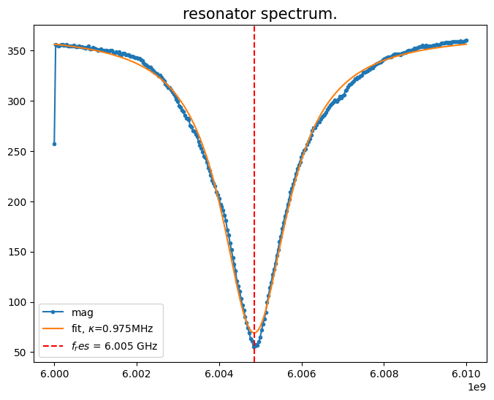
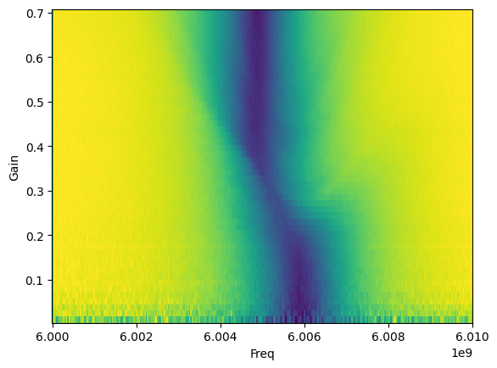
One tone

Slide 14
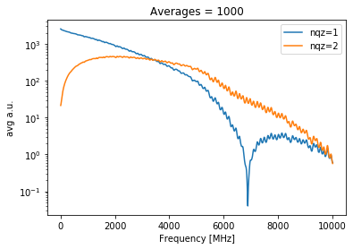
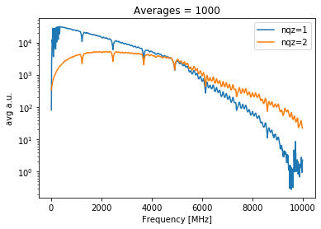
Freq vs output gina
Fs = 6.881GHz
Fs = 9.584GHz

Slide 15
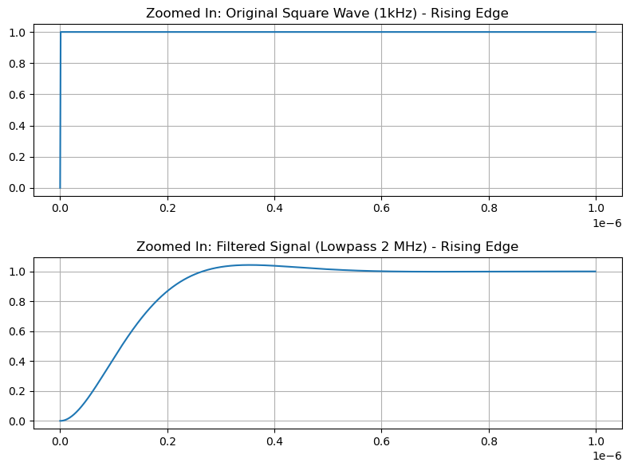
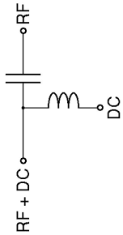
One tone vs flux (by DAC pulse)
Dac0
Flux
saturate
resonator
Local flux line
saturate

Slide 16
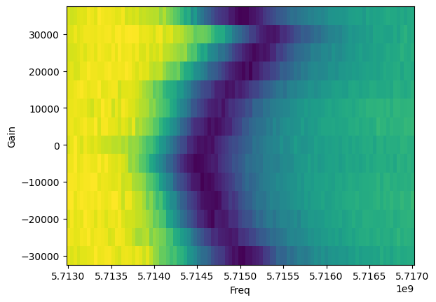
One tone vs flux (by DAC pulse)
Dac0
Flux
saturate
resonator
Local flux line

Slide 17
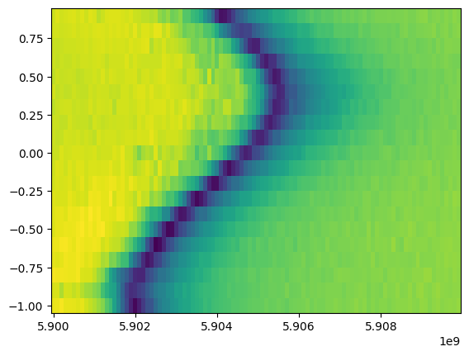
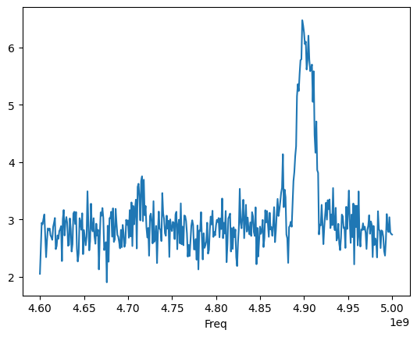
Two tone
One tone vs flux
Two tone at max frequency

Slide 18

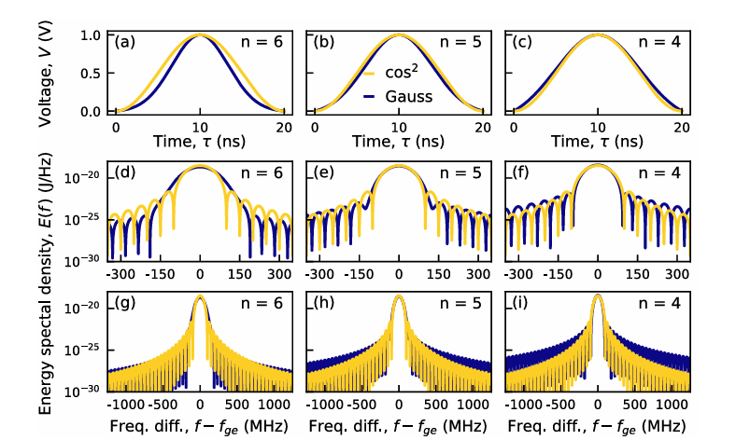
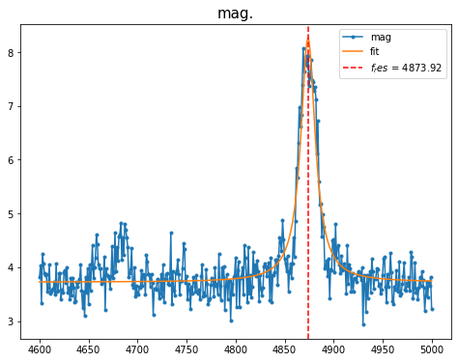
Two tone
Gaussian: blue
Cosine: yellow

Slide 19
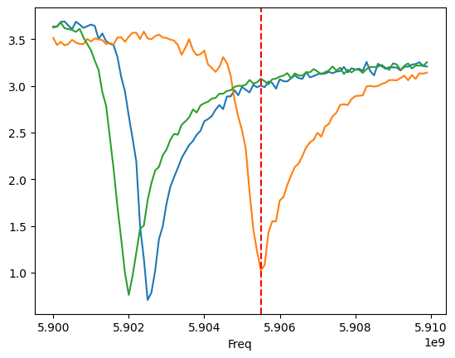
How to get full two tone spectrum?
?

Slide 20
Two tone fast flux spectrum
Dac0
Don’t be too long
Fast flux
Dac0
Qubit
Dac1
Resonator
Dac3
ADC demode
ADC0
Local flux line

Slide 21
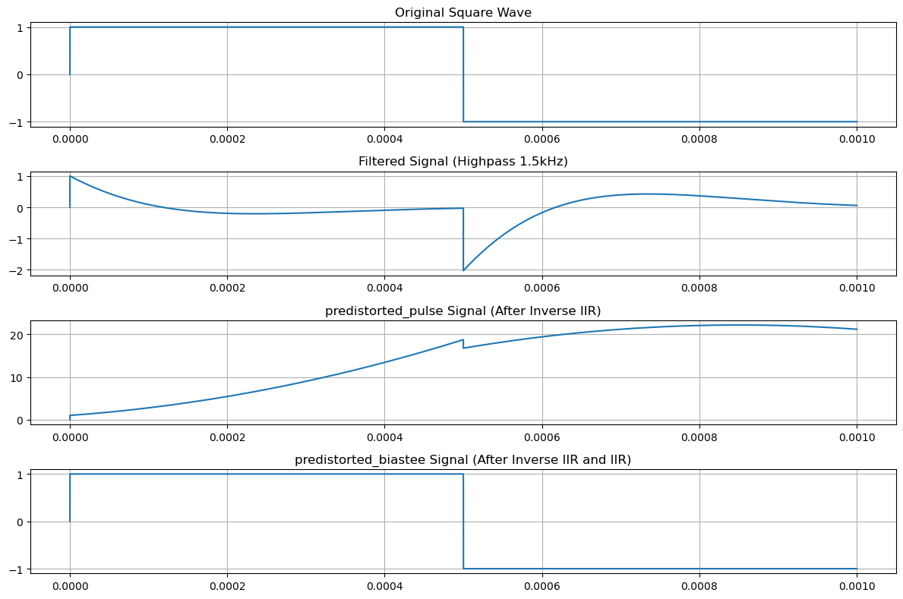
Two tone fast flux spectrum
Dac0
Like high pass filter
Local flux line

Slide 22
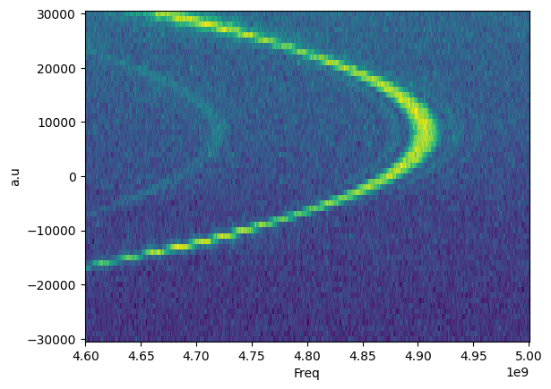
Two tone vs flux (DAC pulse)

Slide 23
Auto measure step
Two tone → qubit frequency by fitting
Amplitude Rabi → pi, pi/2 gain by fitting
T2 with activate detune → correct the frequency
Amplitude Rabi chevron → more correct pi, pi/2 pulse
T1
Dispersive shift → get optimize readout frequency

Slide 24
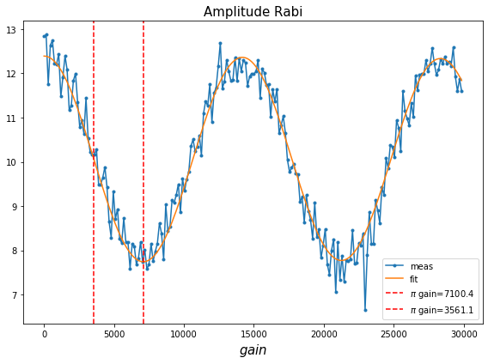

Slide 25
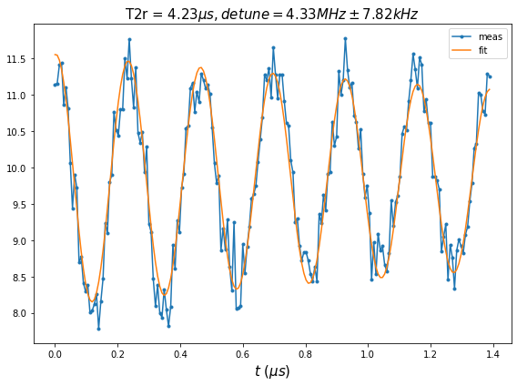
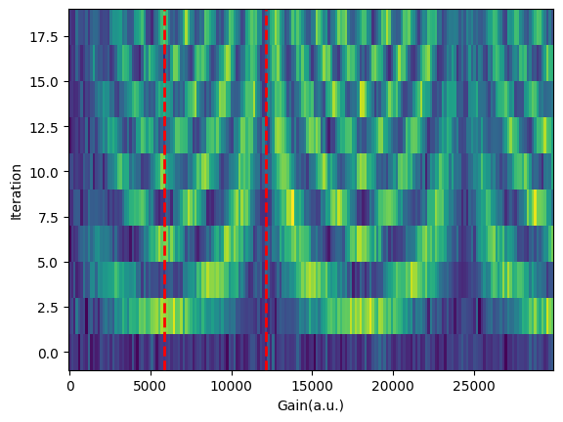

Slide 26
More correction for amplitude drive
PI
PI
PI
PI
……
PI
PI
Resonator
ADC demode

Slide 27
Pros & cons with Rabi chevron
Pros
Easy to do
Doesn’t need very good SNR
Cons
Need more precisely time step
Take lots of time to get a 2D plot

Slide 28
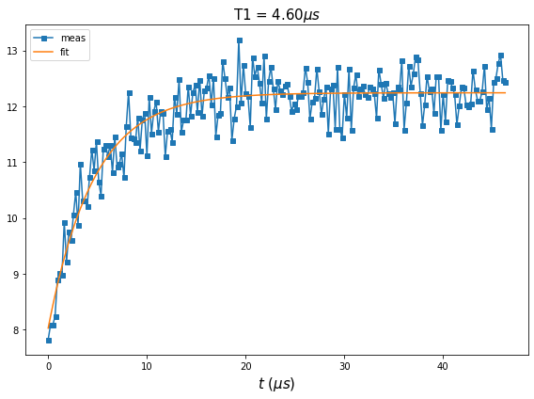
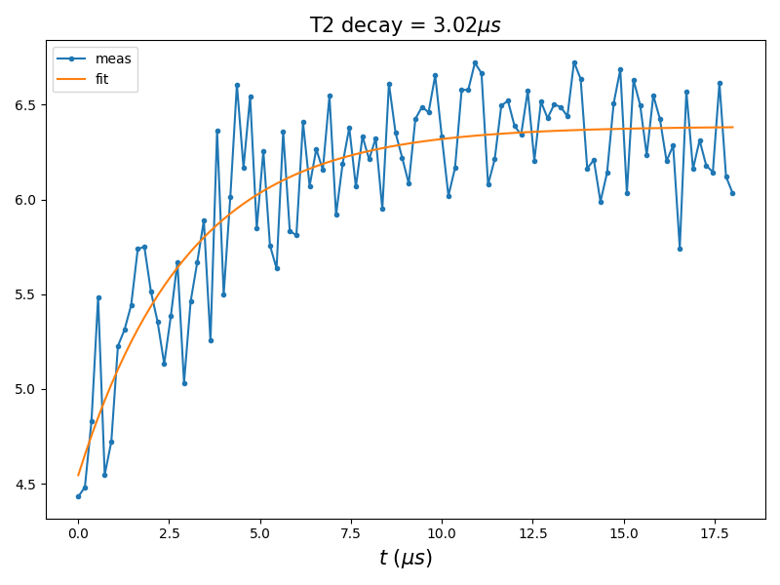

Slide 29
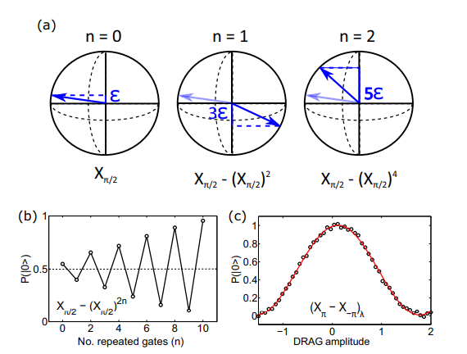


Optimize amp optimization procedure
Ref: Characterizing errors on qubit operations via iterative randomized benchmarking

Slide 30
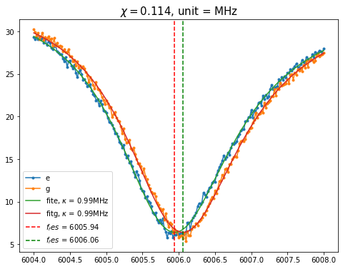
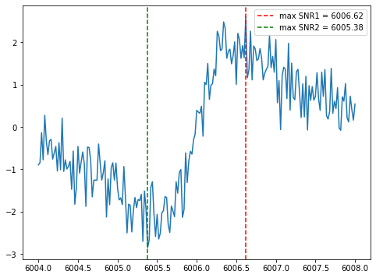
Readout frequency optimize
0/PI
Sweep Resonator freq.
ADC demode
Relax

Slide 31
Tune up single qubit
Two tone spectrum
Amplitude rabi
T2 Ramsey + activate detune(5MHz) → Find the correct frequency
Back to Amplitude rabi by using correct frequency
Rabi chevron optimize
T1
Dispersive shift measurement → Find highest readout SNR point
Will replace by pi pulse vs readout frequency

Slide 32
Next! Go single shot
Now you get
Correct qubit resonance frequency
Correct pi pulse amplitude ( also pi/2)
Highest Readout SNR point

Slide 33
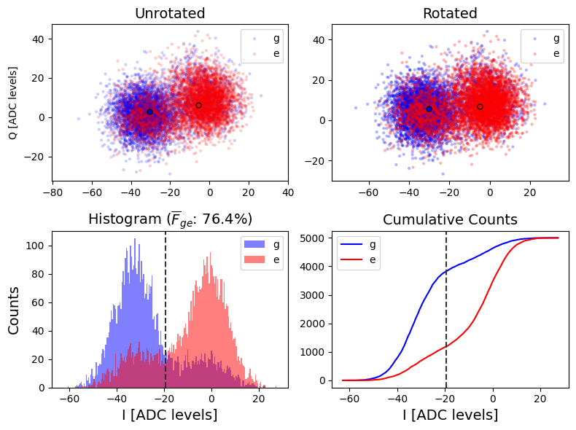
Single shot without Quantum amplifier

Slide 34
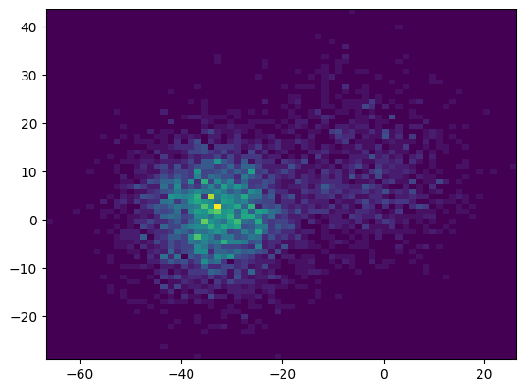
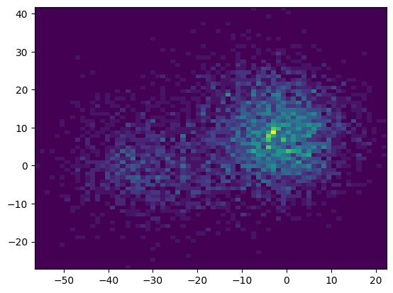
|0>
|1>

Slide 35
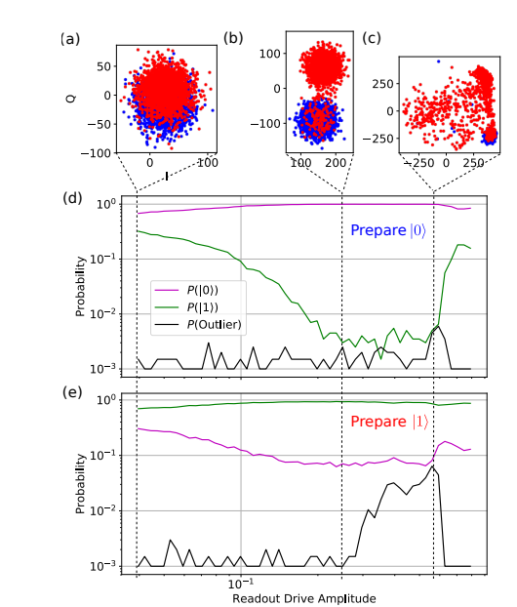
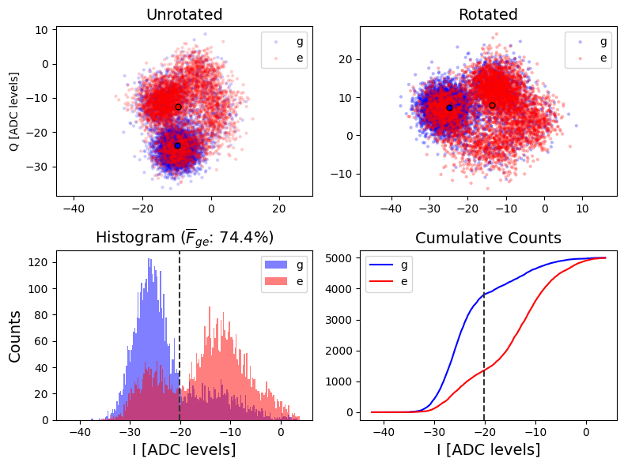
Integration too long or amp too high
1.5us integration
Ref: Metrology of Quantum Control and Measurement in Superconducting Qubits
Notes:
Metrology of Quantum Control and Measurement in Superconducting Qubits

Slide 36
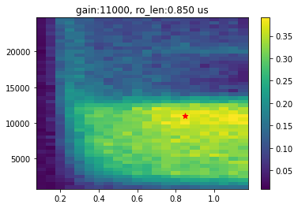
Single shot optimize
Gain vs integration vs fidelity

Slide 37
Next step
Introduce |f> state into consideration

Slide 38
Conclusion
We get high single qubit performance on ZCU board.
Full stack fitting function to be able auto calibration
Fast flux pulse driven by qick → ready for Two qubit gate

Slide 39
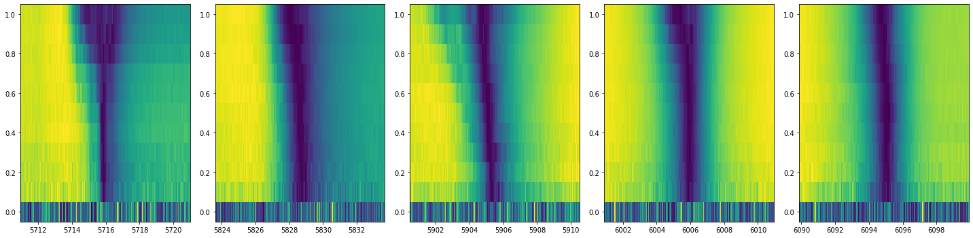
Future work- Multi qubit crosstalk calibration

Slide 40
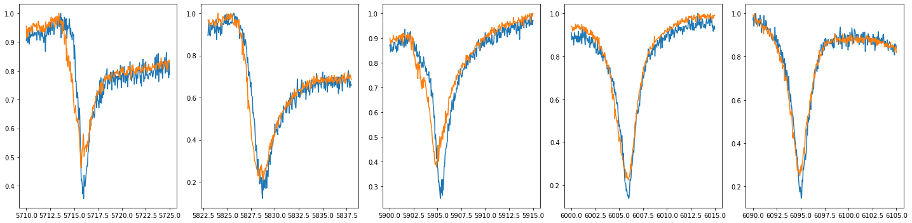
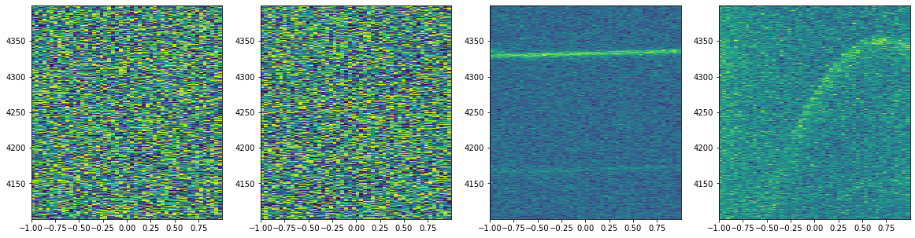

Slide 41
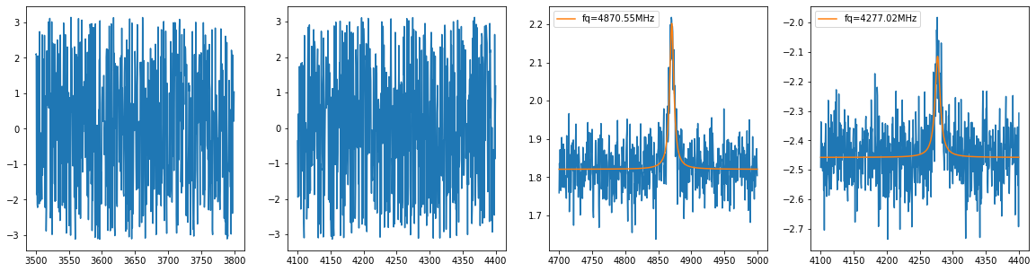
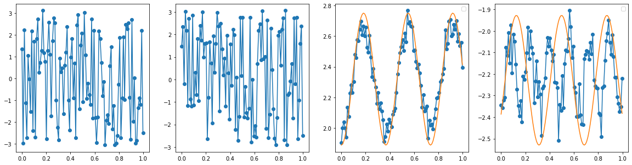

Slide 42
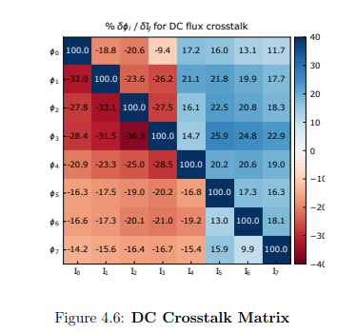
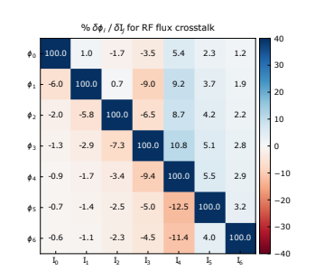
Rf crosstalk
DC crosstalk
Ref: QUANTUM FLUIDS IN A BOSE-HUBBARD CIRCUIT, GABRIELLE LYA CASTIAUX ROBERTS

Slide 43
Thanks

